Slide 1

BIRDVILLE ISD
CAMPUS BUDGET MEETING
ELEMENTARY – DECEMBER 6, 2022
SECONDARY – DECEMBER 7, 2022

Slide 2
Budget resources
Budget Development Calendar
2023-24 Summary Budget Worksheet
2023-24 Campus Detail Budget Worksheet
BISD Campus Allotment
Available on District website Finance/Financial Reports/Budget/District Budget Preparation Documents https://www.birdvilleschools.net/Page/59647
  General Fund Budget Position Form Position Review Request Form
  Request – Additional Non-Personnel New Account Code Request Form
  Facilities Modification Request Furniture Request
  Budget Code Helpful Hints Sample Teacher/Staff Request Form

Slide 3
Budget Process

Slide 4
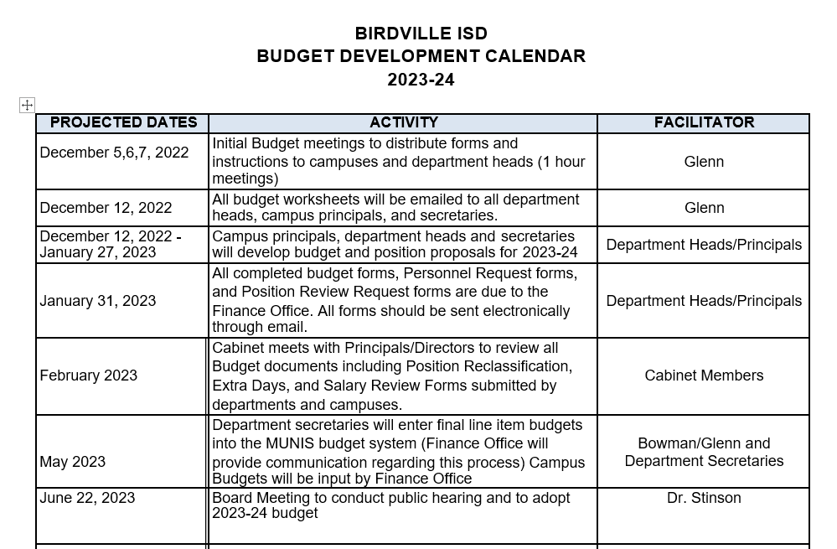
Budget development calendar

Slide 5
Campus Budget Resources
Funding
  ESSA Financial Transparency reporting will utilize these funds in the per pupil expenditure calculation
    Campus Site-Base Fund 199 Allotment
    Campus Funds – Fund 461
    Federal Funds – i.e. Fund 211, etc.
Campus Staff and District Support
  Campus staff should have input into the budget development for your campus
    Different ways to involve your staff would be
      Grade Level
      Area Specific
    Sample Form is available on the website
  District budget staff and program/curriculum staff are available should you need their assistance

Slide 6
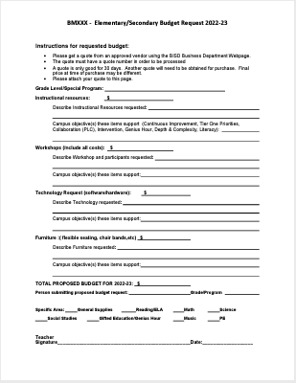

Slide 7
Campus Improvement Plan
Resources should be allocated based on addressing the goals of your Campus Improvement Plan
  Budget to the Plan, don’t Plan to the Budget
Expenditures should be planned with a focus on the Campus Improvement Plan
  Are they supportive of the goals?
  Are they curriculum driven?
  Are they results-oriented?

Slide 8
Budget development and curriculum development should be intertwined, the latter preceding the former. The budget ought to be curriculum driven when too often that is not the case.
Curriculum Management , 1987
Fenwick English

Slide 9
Planning Process Considerations
Each budget request shall be described so as to permit evaluation of consequences of funding or non-funding in terms of results
  Request for Additional Non-Personnel Budget
Prioritizing of budget requests should include key educational staff, including principals and teachers
Rank ordering of requests allows flexibility in budget expansion, reduction, or stabilization based on changing needs and priorities.
Budget requests publicly compete with each other for funding based upon evaluation of need and relationship to effective instruction and campus quality.

Slide 10
Campus Site-Base Funding –
BISD Fund 199 Allotment
  Per Pupil Allotment (at 100% of October 2022 enrollment)
    Elementary - $53 per student
    Middle School - $67 per student
    High - $71 per student
  Cafeteria Monitors
    Elementary only - $4,750
    Unspent funds can be moved to instructional supplies
  Travel (Function 23)
    $800 – Principal
    $300 – Assistant Principal

Slide 11
Campus Site-Base Funding –
BISD Fund 199 Allotment Cont’d
  Library Book Funds (199-12-6329)
    $9.50 per student
    Must be used for books
  Library Supplies
    $250 per campus
  Nurse Supplies (199-33-6399)
    $1 per student

Slide 12
Campus Activity Funding – Fund 461
While a budget “per se” is not required, the resources generated in this funding source should be considered in your budget planning.
The actual expenditures from this funding source are reported to TEA through the mid-year PEIMS submission.
ESSA Financial Transparency reporting will utilize these funds in the per pupil expenditure calculation

Slide 13
Federal Funds
Funding per campus specific to programs on the campus with limited use
These funds can be utilized for appropriate expenditures and should be considered in the campus budget planning
  i.e. Staff Development on a Title I campus
The actual expenditures are reported to TEA through the mid-year PEIMS submission
ESSA Financial Transparency reporting will utilize these funds in the per pupil expenditure calculation

Slide 14
Budget Considerations
Budget Roll-Forward
  The lesser of 10% of the 22-23 adopted fund 199 budget or the remaining 22-23 budget funds will be allocated to campuses
  Fund 461 funds are rolled forward from year to year with no limitations
Copy Machines
  Lease payment and 7 copies per student per day will be funded to campus fund 199 budget from the Technology Department budget to be posted in July
  Copy cost over allotment will be responsibility of the Campus, either fund 199 or 461
Budget Rollup
  199-11-XXXX-XX-XXX-XX-101
  461-XX-XXXX-XX-XXX-XX-101

Slide 15
Substitutes
Basic Substitute Needs – Funded by District
  Employee Illness
  Personal Days
  Vacant Positions work w/HR
Substitutes required by Departments
  Contact Department for sub-code
Staff Development Subs
  Utilize current request form online
Substitutes – Campus Discretion
  Additional Staff Development, Staff Meetings, additional help
  Campus should include in budget planning
    Remember that Fund 461 can also help with these costs

Slide 16
Budget Considerations – Cont’d
Don’t just budget as you have in the past….
  Review budget amendments that you have had to make to move funds around this year
  Review recently added projects/programs to determine if future funding is needed
  Make sure that new projects/programs are coded appropriately

Slide 17
Budget submission
Due January 31, 2023

Slide 18
Personnel Requests
Complete the appropriate form and include details on the Budget Summary Worksheet – Personnel Budget Request section
    Submit forms with budget worksheet
      Include Job Description if new position/Stipend or duties have changed
    Do not include staff normally received through staffing formulas or federally funded positions
      If Federal funds are decreasing causing staff to be unfunded and the position is needed – you have to complete this form
  General Fund Budget Position Form
    Use for new positions and stipends
    Include all costs associated with the position including required travel, training, furniture, etc.
  Position Review Request Form
    Use this form for additional days, pay grade reclassifications, unfunded federally funded positions or salary reviews
    Include updated job description, if appropriate
    Add to the Budget Worksheet

Slide 19
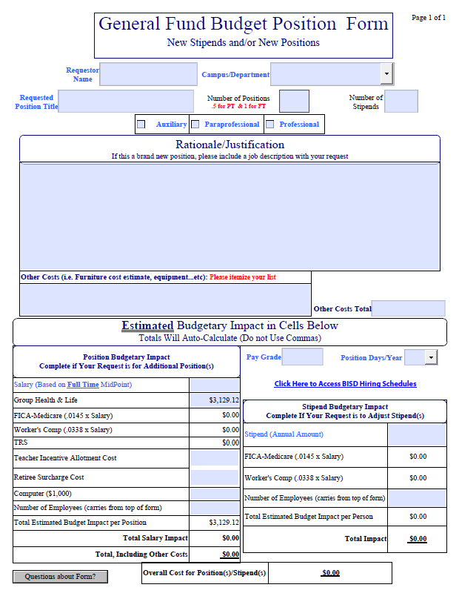
General fund budget position form
New stipends
  Include a job description
New position
  Include a job description
  Be sure to include all costs – furniture, vehicle , etc.

Slide 20
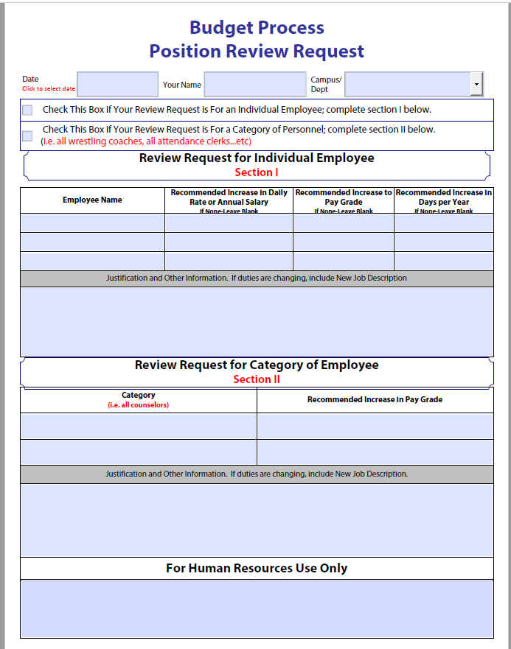
Position review request
Be sure and include a new job description if adjustment is a result of duties changing
If Federal Position will not be funded next year and you want to fund this position with local funds, this form is needed
Add to Budget Worksheet

Slide 21
Additional non-Personnel Requests
Complete the appropriate form and include details on the Budget Summary Worksheet – Additional Non-Personnel Budget Request section
    Submit forms with budget worksheet
  Additional Non-Personnel Budget form
    Use for new programs/projects
    Include all costs associated with the program/project
  Facility Modification Request
    Utilize for all modifications that you are considering for your campus/department that will need to be funded
    If you have submitted a FMR in the past and it has not been addressed – be sure and include it in the budget process
    Add to the Budget Worksheet
  Furniture Modification Request
    Utilize for all modifications that you are considering for your campus/department that will need to be funded
    If you have submitted a FMR in the past and it has not been addressed – be sure and include it in the budget process
    Add to the Budget Worksheet

Slide 22
Facility modification/Furniture Requests
Complete the appropriate form – Add to Budget Worksheet -Requests for Additional Non-Personnel Budget and Submit with Budget worksheet
  Include enough information for the respective departments to complete cost estimates
Will be reviewed by Cabinet
Once Endorsed by Cabinet – Respective Department will provide cost estimates
Will be considered in budget funding prioritization process

Slide 23
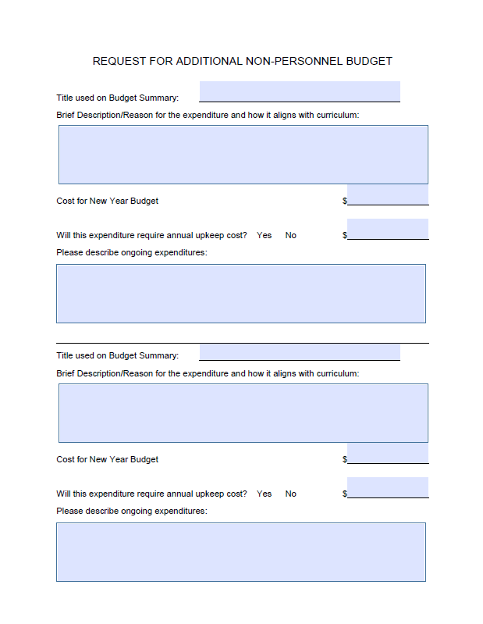
request for additional non-personnel budget
This will need to be submitted for each project/expenditure you request
  Title so that form and line item can be tied together
Include detailed information
  Remember this is the information that will be used to determine if funding will occur
Include on Budget Summary worksheet

Slide 24
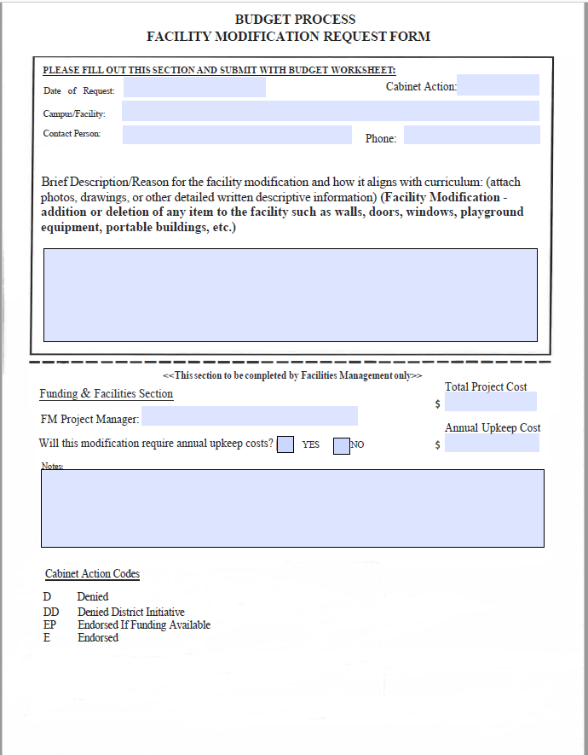
Facility modification request
Utilize for all modifications that you are considering for your campus/department that will need to be funded
  If you have submitted a FMR in the past and it has not been addressed – be sure and include it in the budget process
Include the Project on the Budget Worksheet -Requests for Additional Non-Personnel Budget

Slide 25
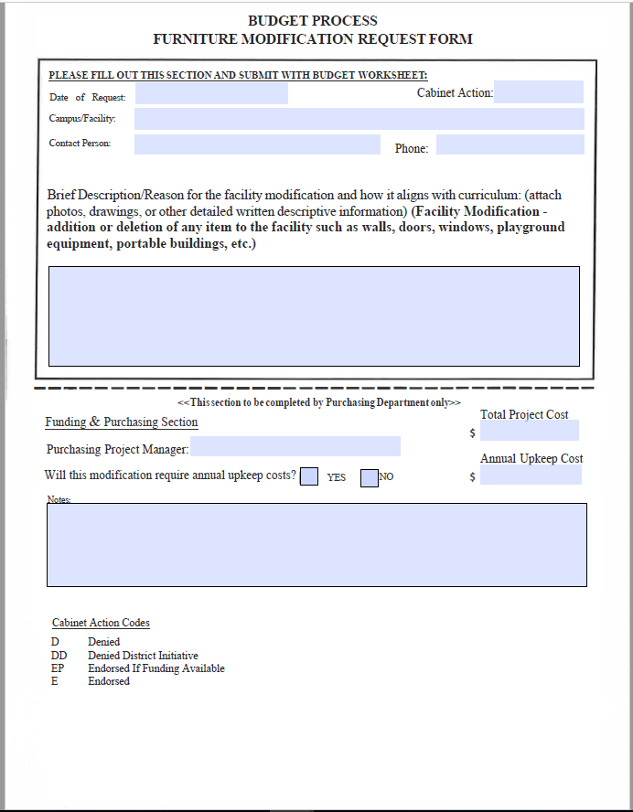
furniture modification request
Utilize for all modifications that you are considering for your campus/department that will need to be funded
  If you have submitted a FMR in the past and it has not been addressed – be sure and include it in the budget process
Include the Project on the Budget Worksheet -Requests for Additional Non-Personnel Budget

Slide 26
Budget Submission Process –
Campus Summary Budget Worksheet
First Section-Proposed Incr(Decr) within my Initial Allocation
  Include any major budget allocation changes within allotment in this section
Second Section-Requests for Additional Non-Personnel Budget
  Include any “non-personnel” requests in this section
    Don’t forget to include Facilities Modifications and Furniture Modifications
    Don’t forget to submit Forms needed to support requests
  This represents amounts over your campus allotment
  These amounts should not be entered on the 2023-24 Campus Detail Budget Worksheet

Slide 27
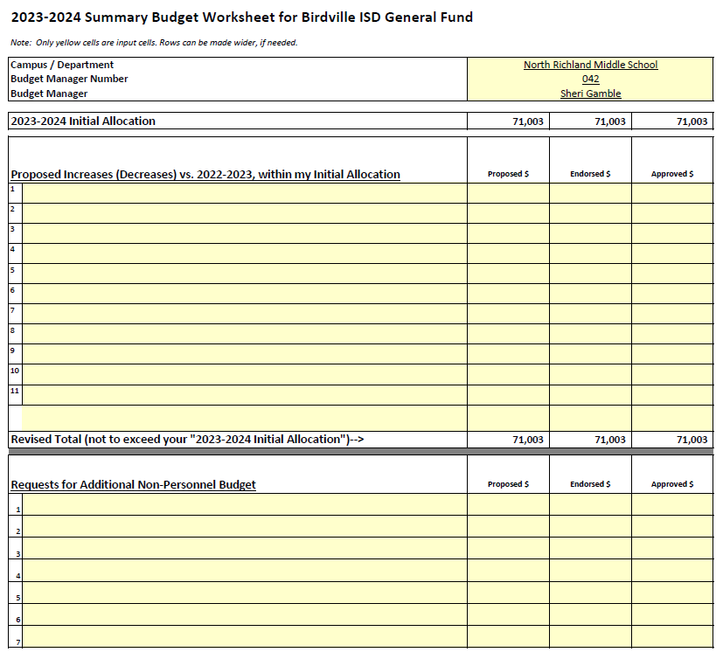

Slide 28
Budget Submission Process –
Campus Summary Budget Worksheet
Third Section – Requests for New Positions & Position Review/Reclassification
  Include description of General Fund Budget Position form(s) submitted
  Include description of Position Review Request form(s) submitted
    Don’t forget to include current Federally funded positions that will need to be moved to General Operating
  Do not include staff normally received through staffing formulas
    Don’t forget to submit the appropriate form

Slide 29
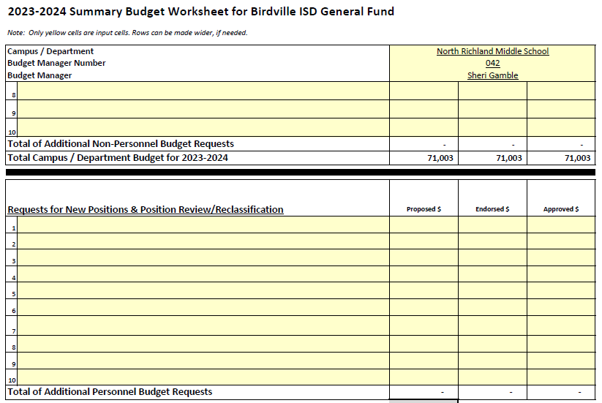

Slide 30
Budget Submission Process –
Campus Detail Budget Worksheet
General Fund (Fund 199) only
  Fund 461 budget not required
  Grant budgets will be developed later in the Spring
Initial Allocation is included at the top of the worksheet and all that is needed to be entered on this worksheet
Enter detailed proposed budget into the 2023-24 Proposed Budget column
Special Allocations have to be submitted as allotted.
  Library Books, Library Supplies, Cafeteria Monitors, Nurse supplies, and Principal Travel
  These are pre-loaded for you
    Can only increase, do not decrease

Slide 31
Budget Submission Process –
Campus Detail Budget Worksheet
Add additional rows as needed (highlight entire line when adding)
  New Account Request Form shall be completed and submitted with budget worksheet if account code is not in Munis – (Review Account Inquiry)
Teachers in special program classrooms are entitled to basic supplies from the campus allocation-supplemental supplies are provided by special program departments
Please add notes in last column as needed
“Additional Amount to Budget” cell should equal zero (-0-) when you are finished

Slide 32
District Budget Coding
Notes:
Christy Presents
Handout Flip Charts -- Christy
Hand out Quicktips sheet -- Dora

Slide 33

We need your help!
You know more about the purchase/expenditure than we do

Slide 34
Budget Coding
Account Code Requirements-Data required by TEA
XXX-XX-XXXX-XX-XXX-XX-XXX - XXXXX
BUDGET
MGR
F
U
N
D
F
U
N
C
T
I
O
N
O
B
J
E
C
T
SUB - OBJECT
O
R
G
A
N
I
Z
A
T
I
O
N
P
R
O
G
R
A
M
P
R
O
JECT

Slide 35
FUND
Funding source
XXX-XX-XXXX-XX-XXX-XX-XXX-XXXXX
100’s-General Fund
200-400’s-Special Revenue Funds
  461 – Campus Activity Fund
500’s-Debt Service Funds
600’s-Capital Project Funds (Bond Projects)
800’s – Agency Funds
  865 – Student Activity Fund
  890 – Faculty Activity Fund

Slide 36
FUNCTION - Purpose of the Expenditure
XXX-XX-XXXX-XX-XXX-X-XX-XXX
11 Instruction (Activities directly between teachers and students) *
12 Instructional Resources and Media (Library) *
13 Curriculum Development and Instructional Staff Development *
21 Instructional Leadership
23 School Leadership (Principal & Office Staff) *
31 Guidance, Counseling, and Evaluation Services *
32 Social Work Services
33 Health Services (Nurses) *
34 Student (Pupil) Transportation (To/From School Only)
35 Food Services (Cafeteria Services Only)
36 Cocurricular/Extracurricular Activities *
41 General Administration (Administration Offices)
51 Plant Maintenance and Operations
52 Security and Monitoring Services
53 Data Processing Services
61 Community Services
71 Debt Service (capital leases)
81 Facilities Acquisition and Construction

Slide 37
OBJECT CODE
Nature or Object of account
XXX-XX-XXXX-XX-XXX-XX-XXX-XXXXX
6100’s-Employee Salary and Benefits
6200’s-Professional & Contracted Services
6300’s-Supplies & Equipment < $5,000 per unit cost
6400’s-Dues, Travel, Food and Other Expenses
6600’s-Capital Assets >$5,000 per unit cost

Slide 38
Payroll Costs
Object 6100
Substitutes – 6112
Part-Time Employees (no benefits)
  XX-6118 Professional
  XX-6126 Part-Time Support Personnel
Extra Pay Full-Time Employees
  XX-6118 Professional Stipends & Extra Duty Pay
  XX-6121 Extra Duty Pay/Overtime Support Personnel
Note: There should be no 6119 or 6129 object codes in campus or department budgets. These are for full-time positions only.

Slide 39
Professional & Contracted Services
Object 6200
Professional Services (typically a licensed individual)
  XX-6219
Student Tuition
  11-6229
Education Service Centers Contracted Services
  XX-6239
Maintenance & Repair Services
  XX-6249
Rentals/Operating Leases (copier leases)
  XX-6269

Slide 40
Professional & Contracted Services
Object 6200 (cont’d)
Consulting Services (performance improvement)
  XX-6291
Print Shop Services
  XX-6399-P1 (not 6294)
Other Contracted Services
  XX-6299

Slide 41
Supplies and Materials
Object 6300
Gasoline and Fuel-district vehicles
  XX-6311
Maintenance/Operations-custodial and building maintenance supplies
  51-6319
Textbooks-textbooks purchased by district furnished free to students
  11-6321
Reading Materials-magazine/newspaper subscriptions and books (not workbooks)
  XX-6329
Testing Materials
  11-6339 – instructional tests
  31-6339 – standardized tests
Child Nutrition Only
  35-6341 – 6349

Slide 42
Supplies and Materials
Object 6300 (continued)
Supplies, Furniture, Equipment (unit cost < $5,000)
  XX-6398 Computer Equipment
  XX-6399-SF Software Licenses
  XX-6399-CQ Copier Clicks
  XX-6399-FU Furniture
  XX-6399-P1 Print Shop
  XX-6399-PA Paper
  XX-6399 All other supplies and equipment

Slide 43
Other Operating Costs
Object 6400
Employee Travel-registration fees, transportation, meals, hotel, etc.
  11-6411 Teacher Instruction Related (Field trips & between campuses)
  13-6411 Teacher Staff Development/Training
  XX-6411 All Other Employees
Student Travel-transportation, meals, participation fees, hotel, etc. related to students traveling for school sponsored events
  11-6412 Regular Instruction (field trips)
  36-6412 Extracurricular/Cocurricular
  6494 District transportation department charges only

Slide 44
Other Operating Costs
Object 6400 (continued)
Non-Employee Travel-registration fees, transportation, meals, and hotel for non-district employees participating in school sponsored events
  XX-6419
Insurance- property insurance, liability insurance, bonding costs, and athletic insurance
  XX-6429
Dues-not associated with travel (fees should be 6499)
  XX-6495
Awards
  XX-6498

Slide 45
Other Operating Costs
Object 6400 (continued)
Miscellaneous Operating Costs-fees, bid notices, newspaper advertisements, food/refreshments for school related meetings, other miscellaneous costs not coded elsewhere
  41 – 6491 Statutorily Required - Bid notices, newspaper advertisements/notices
  XX-6399-F1 Food (non-catered)
    Includes meals and snacks
    Excludes coffee products and water (code to 6399)
  XX-6499-F1 Food (catered)

Slide 46
Sub-Object
District Local Option provides additional account description
XXX-XX-XXXX-XX-XXX-XX-XXX-XXXXX
Can be used to help budget manager to break budget into project/grade levels/etc. to manage budget at a more specified level

Slide 47
ORGANIZATION NUMBER
XXX-XX-XXXX-XX-XXX-XX-XXX-XXXXX
001-040 High Schools
041-100 Middle Schools
101-698 Elementary Schools
699 Summer School
700-750 General Administration
800-997/999 Undistributed
Function 11 requires 001-699 organization code on all expenditures

Slide 48
PROGRAM INTENT CODE - Intent of program provided to students – Very important
XXX-XX-XXXX-XX-XXX-XX-XXX-XXXXX
11 Basic Educational Services
21 Gifted and Talented
22 Career and Technology
23 Services to Students with Disabilities (Special Education)
24 SCE & At-Risk for Non-Title I Campuses
25 Bilingual Education and Special Language Programs
26 Non-disciplinary Alternative Education Programs
28 Disciplinary Alternative Education Program (base level program)
29 Disciplinary Alternative Education Program (supplemental costs)
30 SCE & At-Risk for Title I Campuses
32 Pre-Kindergarten
36 Early education allotment
37 dyslexia
38 college career military ready (CCMR)
91 Athletics and Related Activities
99 Undistributed (not readily distributed to a program intent code)

Slide 49
Local option
District Local Option used as budget manager
XXX-XX-XXXX-XX-XXX-XX-XXX-XXXXX
Computer budget access is based on the budget manager number

Slide 50
PROJECT NUMBER
Project Number used for Activity Funds and Special Projects
XXX-XX-XXXX-XX-XXX-XX-XXX - XXXXX
Mandatory for Activity Funds and Federal Funds

Slide 51
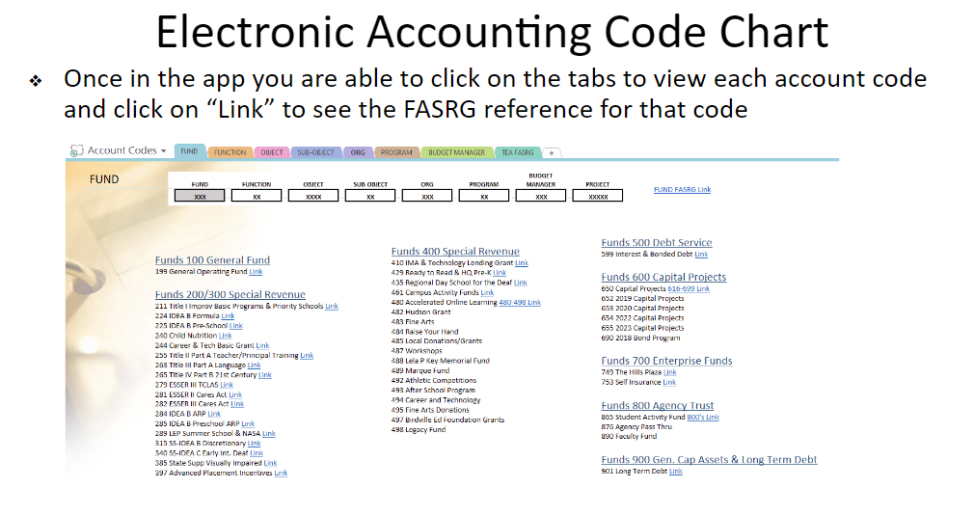
Financial Accountability System Resource Guide (FASRG)
Available on TEA Website
  https://tea.texas.gov/Finance_and_Grants/Financial_Accountability/Financial__Accountability_System_Resource_Guide/
Helpful Matrices for function/object /organization decisions is available

Slide 52
Budget Monitoring

Slide 53
YTD Budget Report - Munis

Slide 54
YTD budget report
Step by Step instructions in Business Procedure Manual
  Fund 199 Accounts
  Activity Funds – 461
Allows for a full picture of your budget
  Remember, once run, it is a point in time, not real time – Account inquiry is real time
Need help running the report, please call Cristina or Shannon

Slide 55
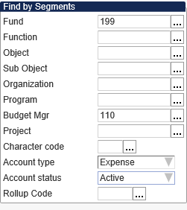
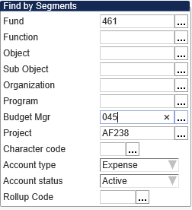
Helpful Hints
Segment Find Settings - 199 Budget
Segment Find Settings - 461 Budget

Slide 56
Account Inquiry
Live picture of your budget – Real Time

Slide 57
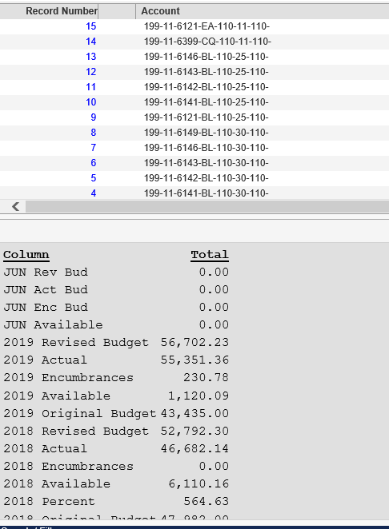
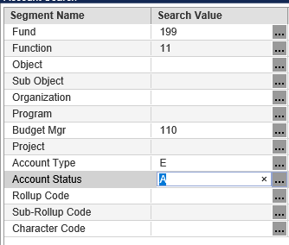
Review from the Browse View

Slide 58
Questions?

